Slide 1


Slide 2
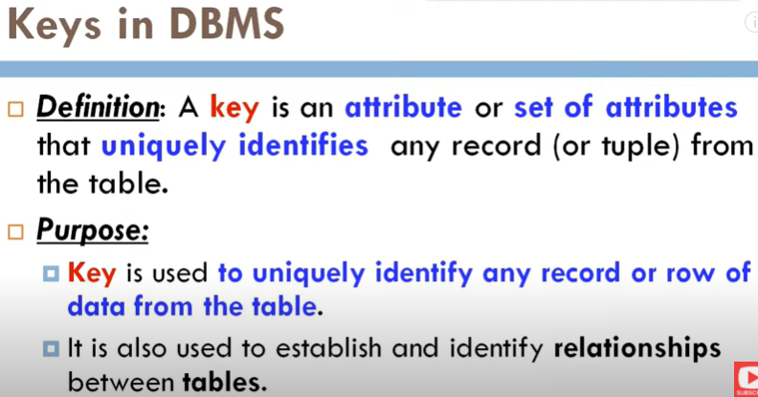

Slide 3

Emp_ID | Name | NID | Email_ID | Dept_ID
01 | Aman | 13579 | Aa_ice@gmail.com | 1
02 | Jetu | 24682 | Bb_ice@gmail.com | 2
03 | Jetu | 13489 | Cc_ice@gmail.com | 2
04 | Tarek | 65874 | Dd_ice@gmail.com | 3

Slide 4
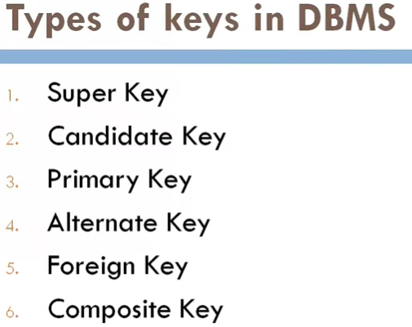

Slide 5
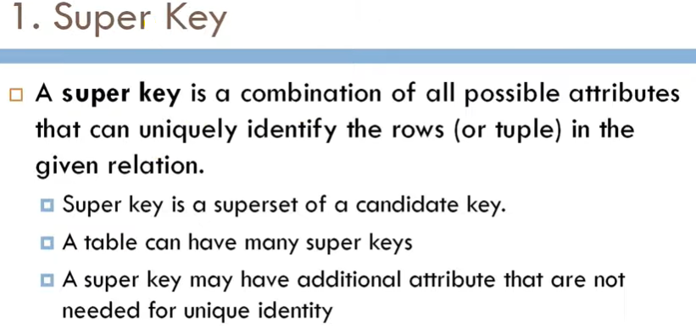

Slide 6

Emp_ID | Name | NID | Email_ID | Dept_ID
01 | Aman | 13579 | Aa_ice@gmail.com | 1
02 | Jetu | 24682 | Bb_ice@gmail.com | 2
03 | Jetu | 13489 | Cc_ice@gmail.com | 2
04 | Tarek | 658743 | Dd_ice@gmail.com | 3
Super Keys:
{Emp_ID}
{NID}
{Email_ID}
{Emp_ID,NID}
{NID. Email_ID}
{Emp_ID,Email_ID}
{Emp_ID,NID,Email_ID}
{Emp_ID,Name}
Etc……

Slide 7
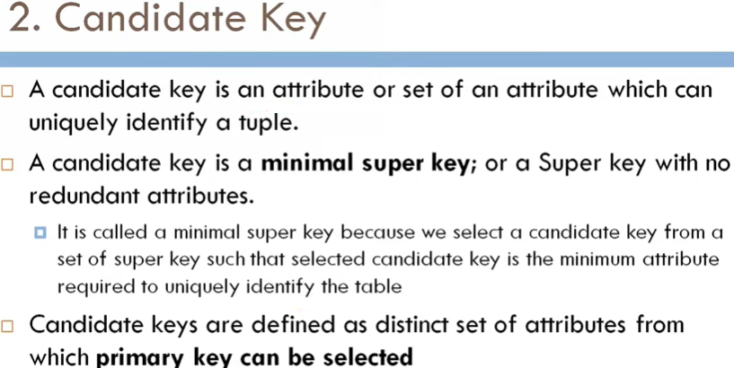


Slide 8
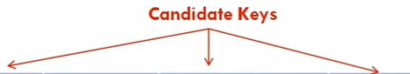
Emp_ID | Name | NID | Email_ID | Dept_ID
01 | Aman | 13579 | Aa_ice@gmail.com | 1
02 | Jetu | 24682 | Bb_ice@gmail.com | 2
03 | Jetu | 13489 | Cc_ice@gmail.com | 2
04 | Tarek | 658743 | Dd_ice@gmail.com | 3
Candidate Keys:
{Emp_ID}
{NID}
{Email_ID}

Slide 9
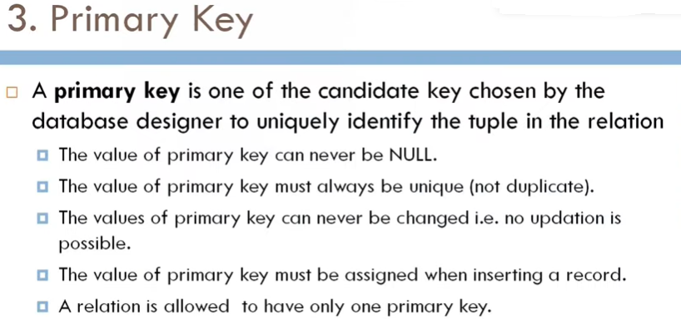

Slide 10
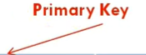
Emp_ID | Name | NID | Email_ID | Dept_ID
01 | Aman | 13579 | Aa_ice@gmail.com | 1
02 | Jetu | 24682 | Bb_ice@gmail.com | 2
03 | Jetu | 13489 | Cc_ice@gmail.com | 2
04 | Tarek | 658743 | Dd_ice@gmail.com | 3
Primary Key:
{Emp_ID}

Slide 11
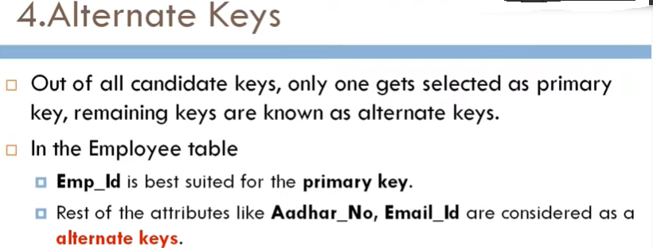

Slide 12
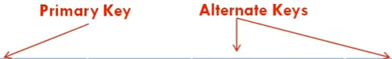
Emp_ID | Name | NID | Email_ID | Dept_ID
01 | Aman | 13579 | Aa_ice@gmail.com | 1
02 | Jetu | 24682 | Bb_ice@gmail.com | 2
03 | Jetu | 13489 | Cc_ice@gmail.com | 2
04 | Tarek | 658743 | Dd_ice@gmail.com | 3
Alternate Keys:
{NID}
{Email_ID}

Slide 13
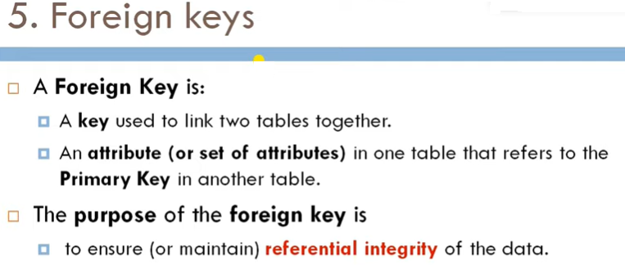

Slide 14
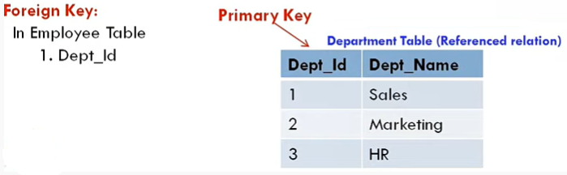
Emp_ID | Name | NID | Email_ID | Dept_ID
01 | Aman | 13579 | Aa_ice@gmail.com | 1
02 | Jetu | 24682 | Bb_ice@gmail.com | 2
03 | Jetu | 13489 | Cc_ice@gmail.com | 2
04 | Tarek | 658743 | Dd_ice@gmail.com | 3

Slide 15
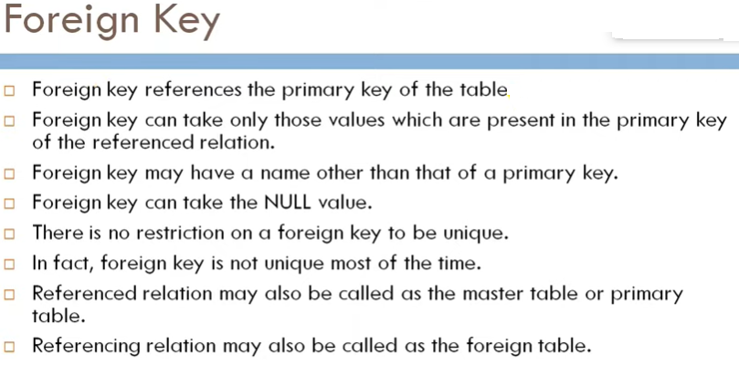

Slide 16
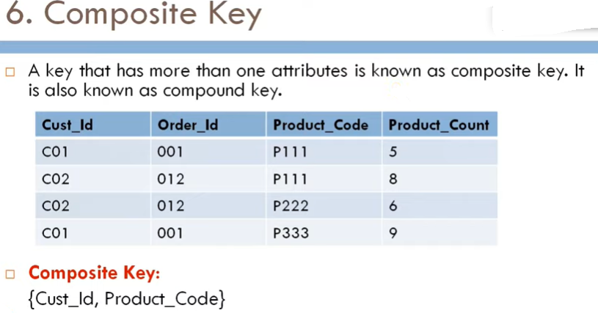

Slide 17
Thanks to All

Slide 18
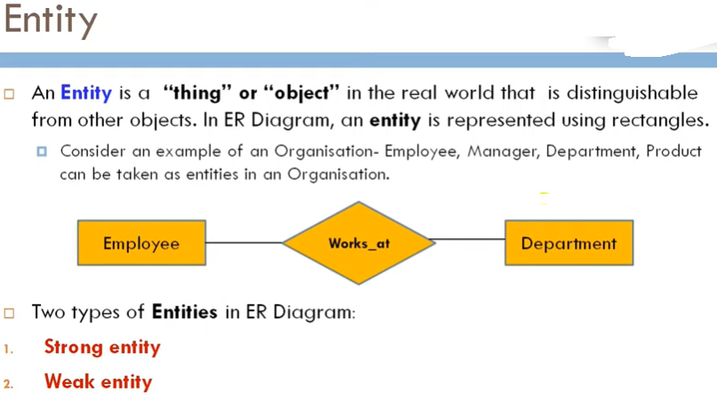

Slide 19
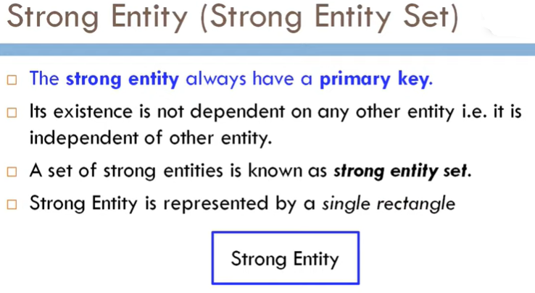

Slide 20
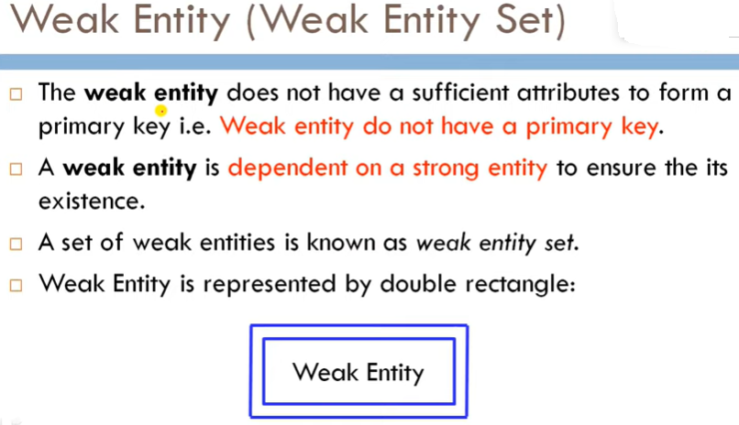

Slide 21
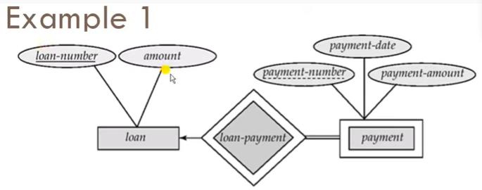
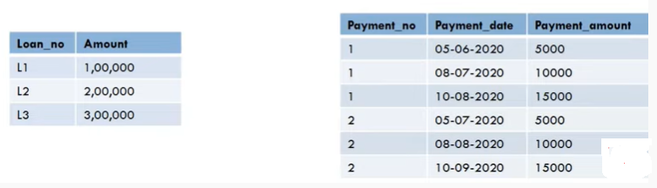

Slide 22

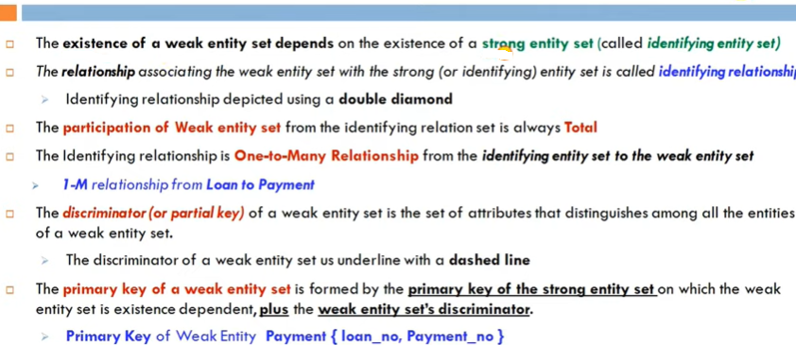

Slide 23

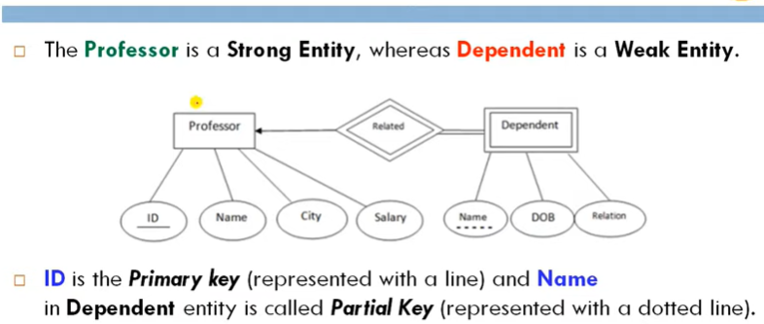

Slide 24
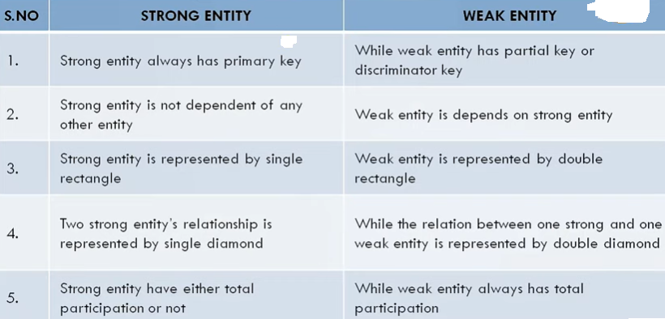

Slide 25



Slide 26
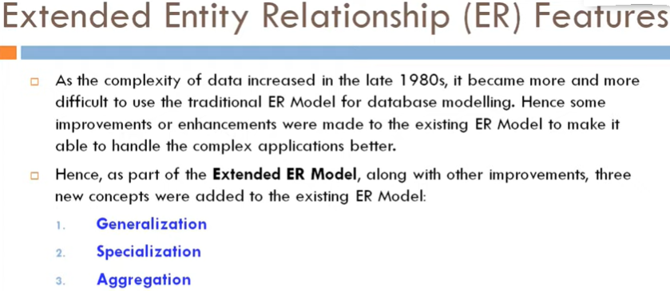

Slide 27

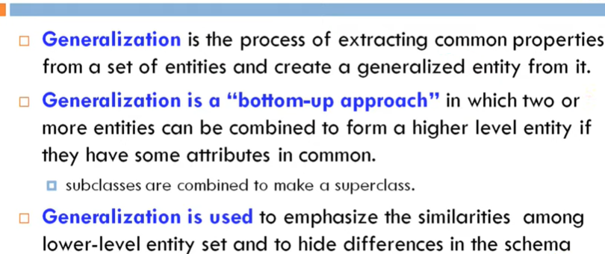

Slide 28
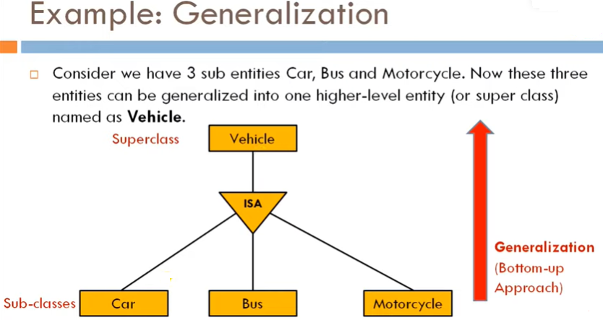

Slide 29

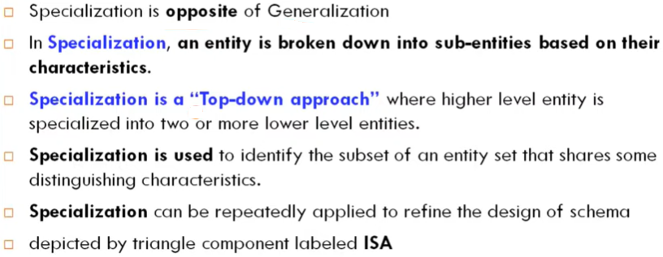

Slide 30
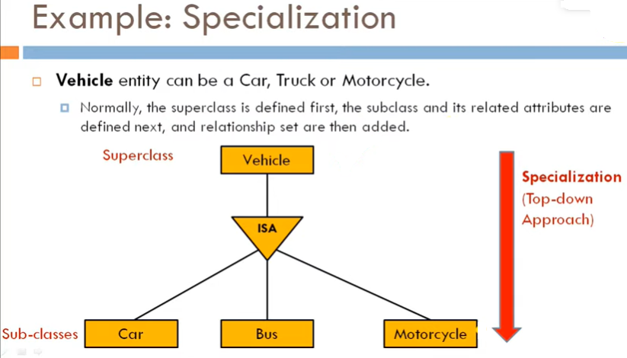

Slide 31
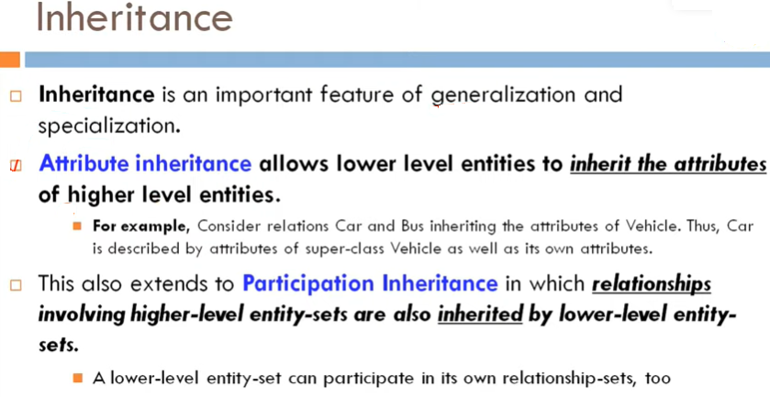

Slide 32
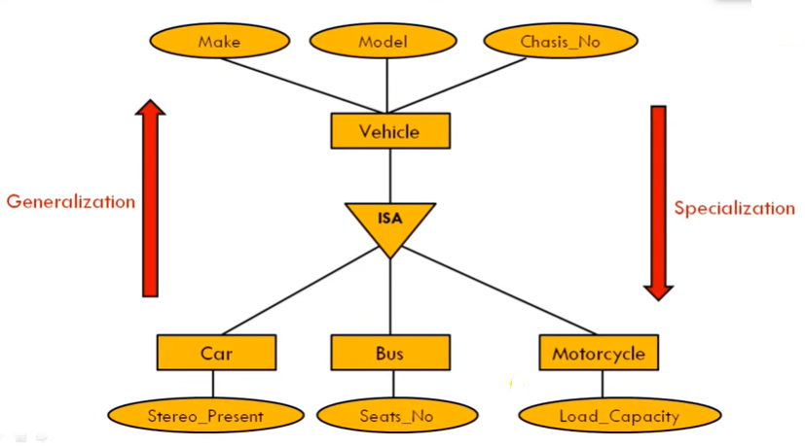

Slide 33
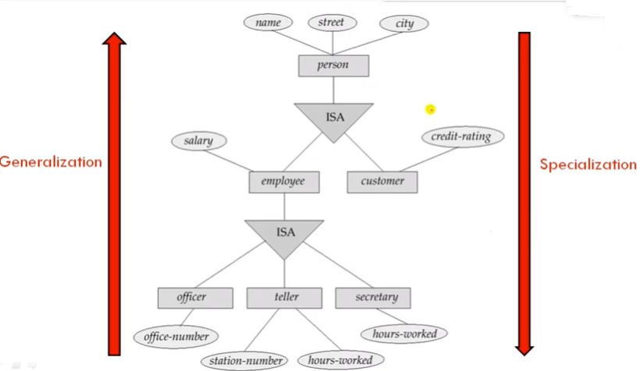

Slide 34
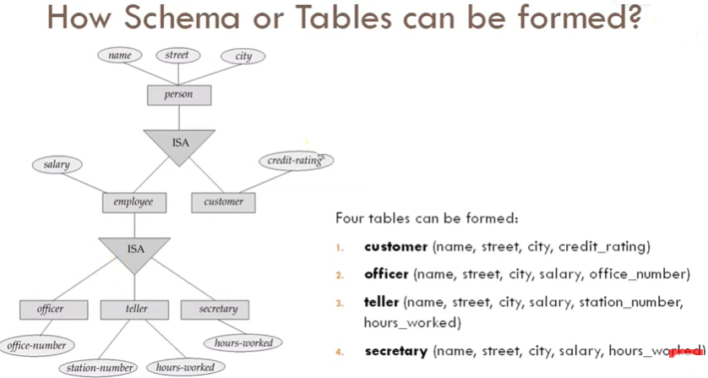

Slide 35
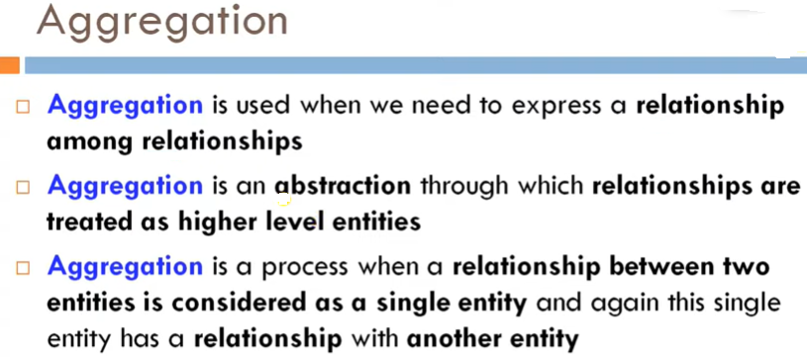

Slide 36
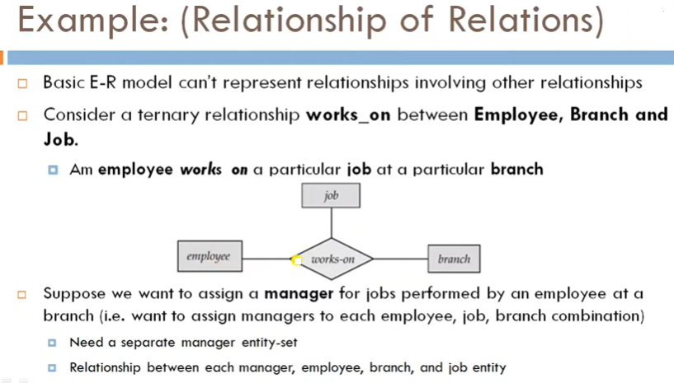

Slide 37
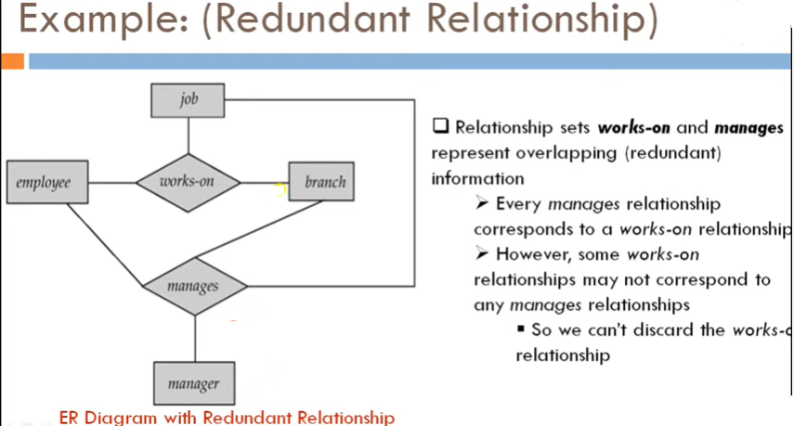

Slide 38
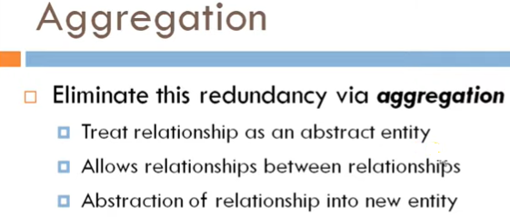

Slide 39
